Slide 1
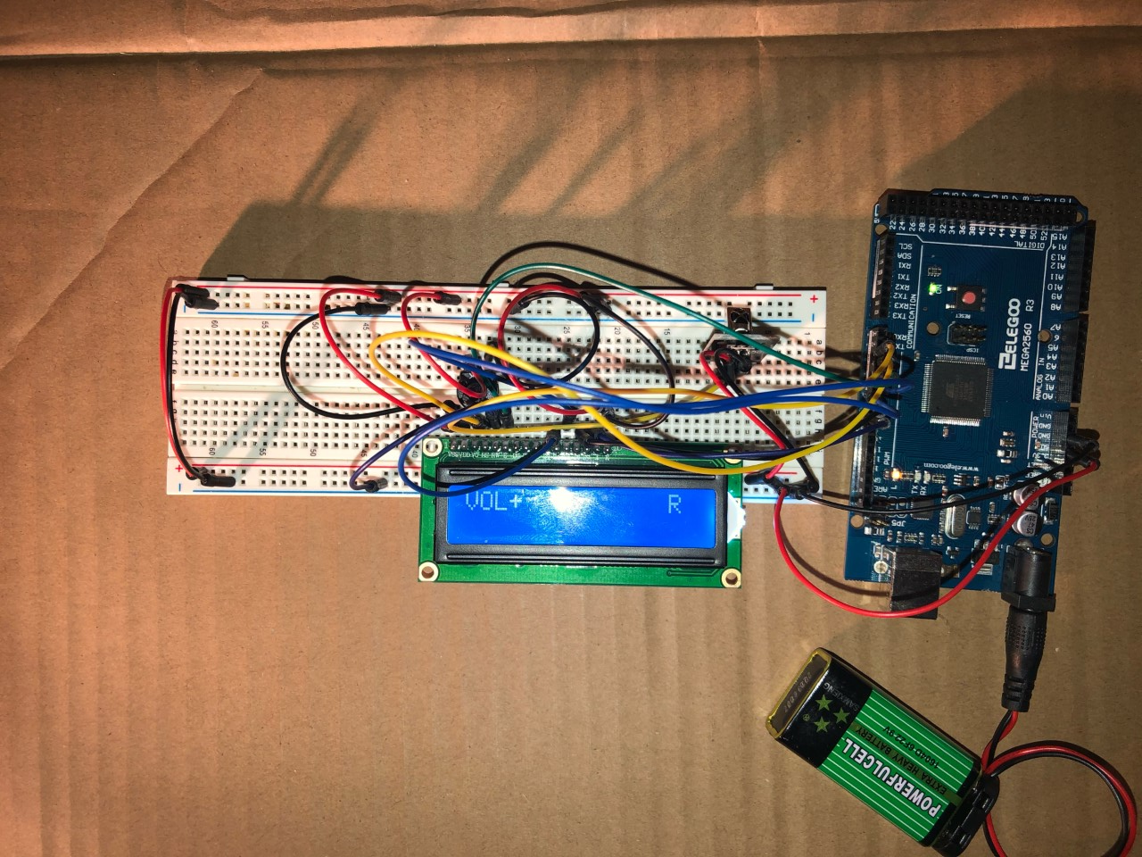
Arduino project: IR receiver and LCD (liquid crystal display)
An “Arduino From Zero” project
© 2020 Adam Wagman

Slide 2
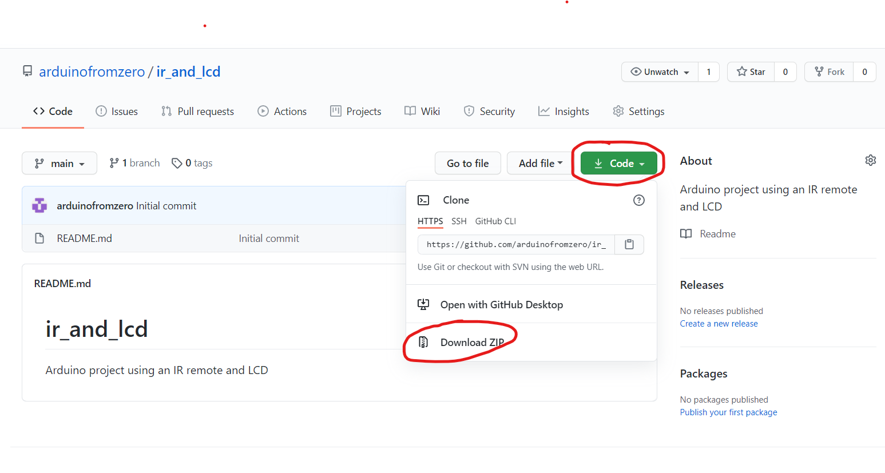
If you just want to dive in:
All of the code, wiring diagrams, and documentation can be downloaded from https://github.com/arduinofromzero/ir_and_lcd. Just click on the “Code” button and then “Download ZIP"

Slide 3
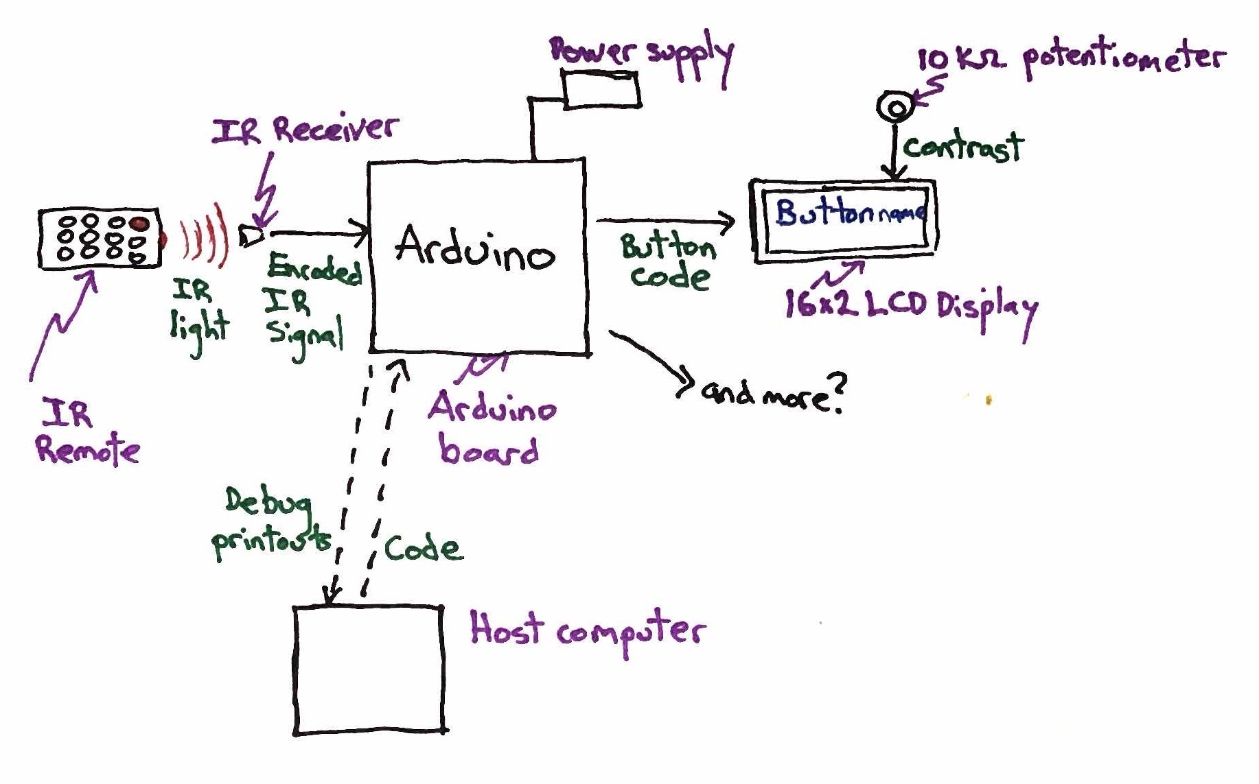
Conceptual hardware diagram

Slide 4
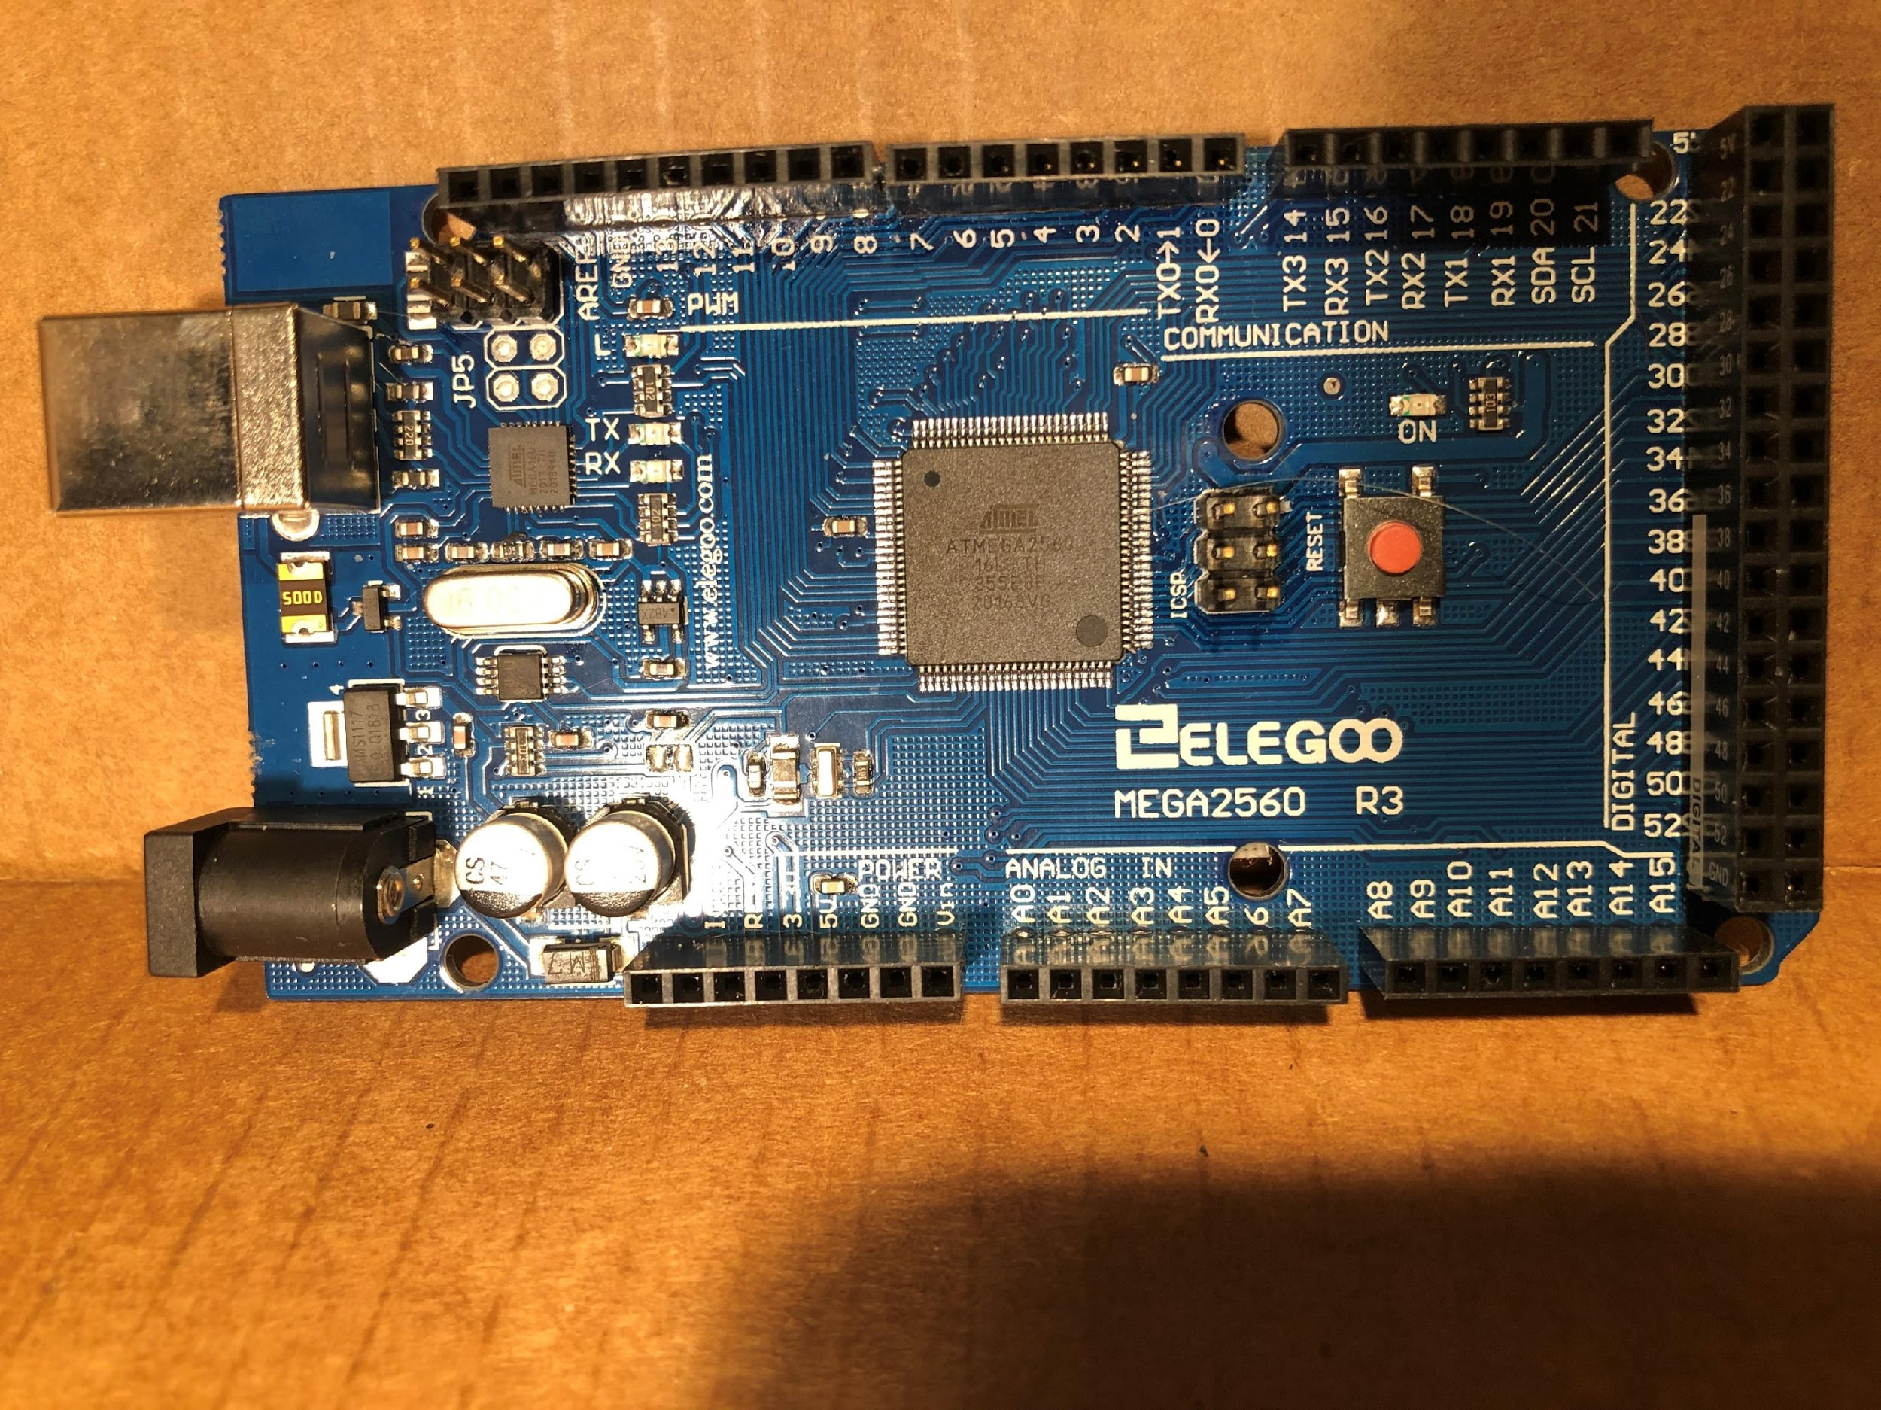
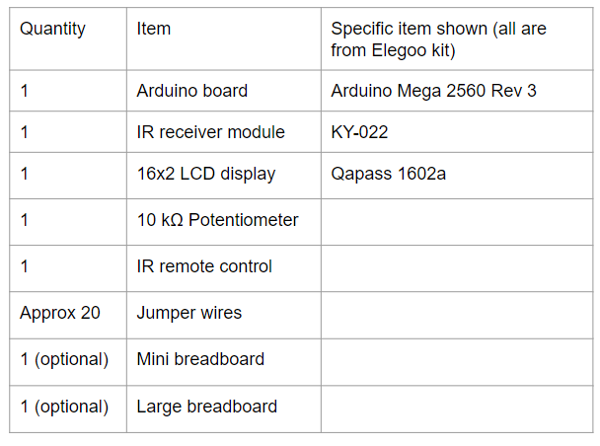
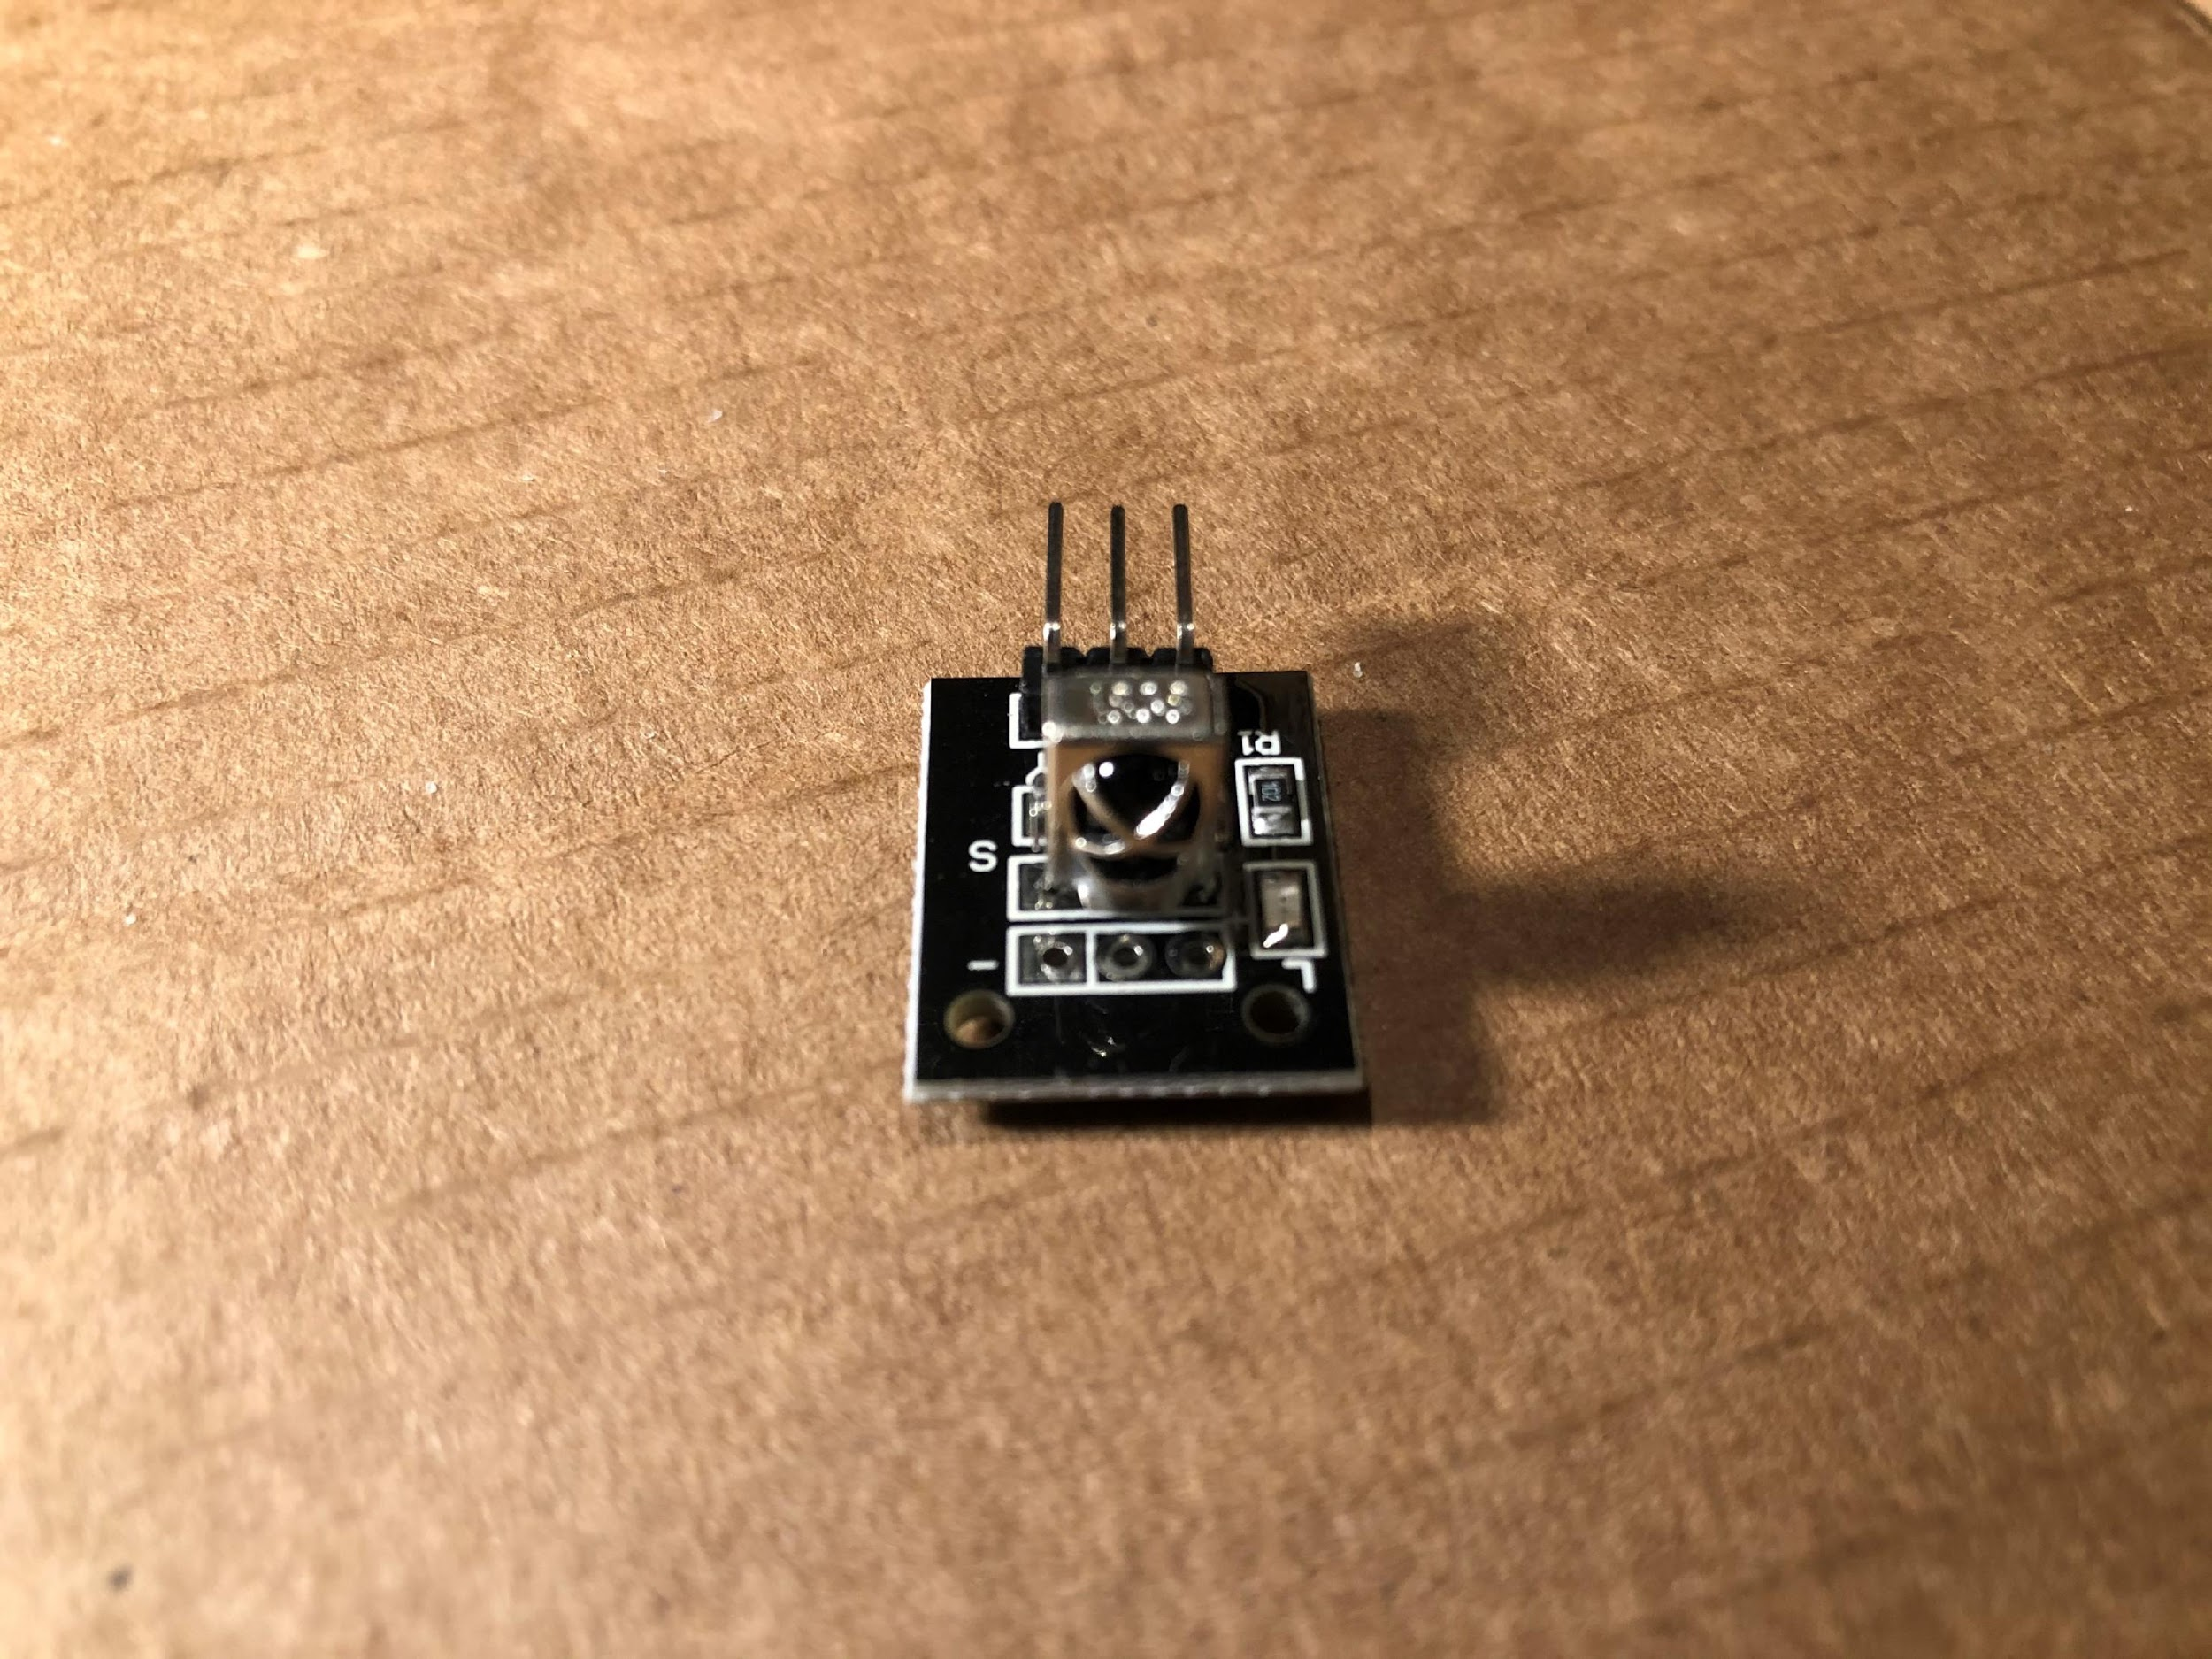
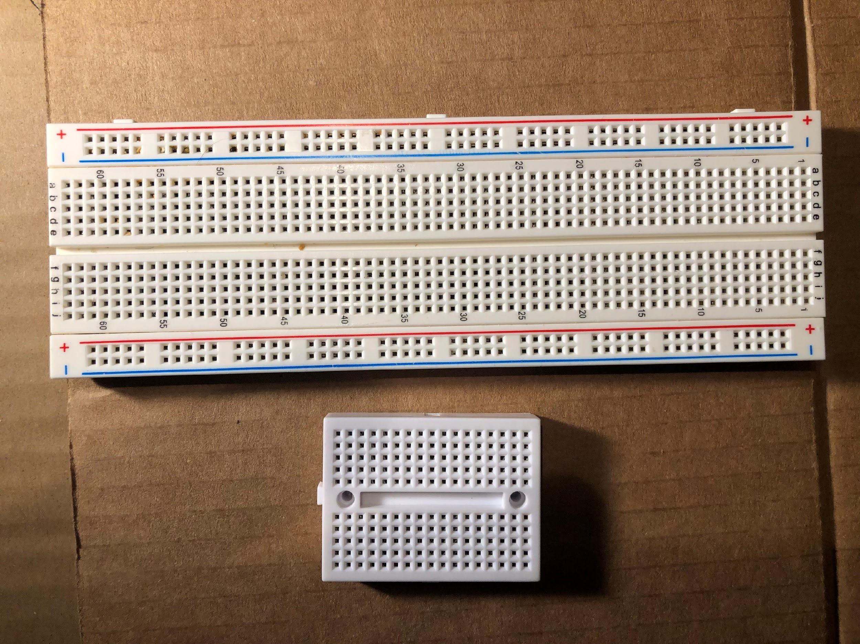
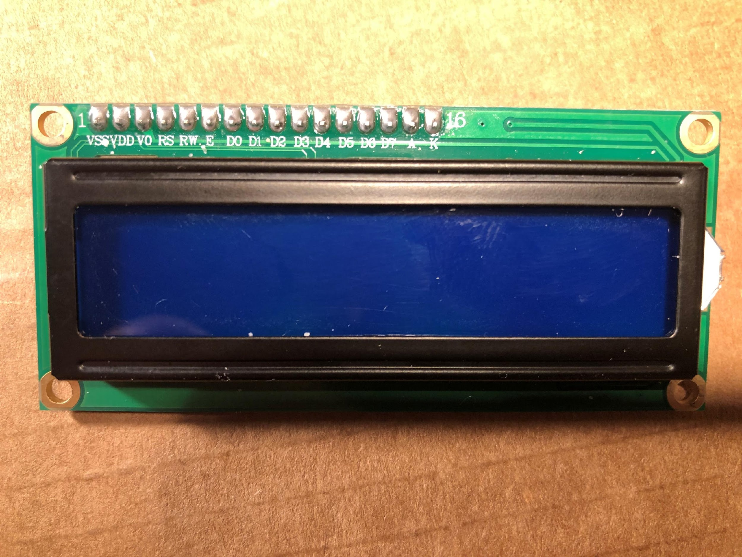
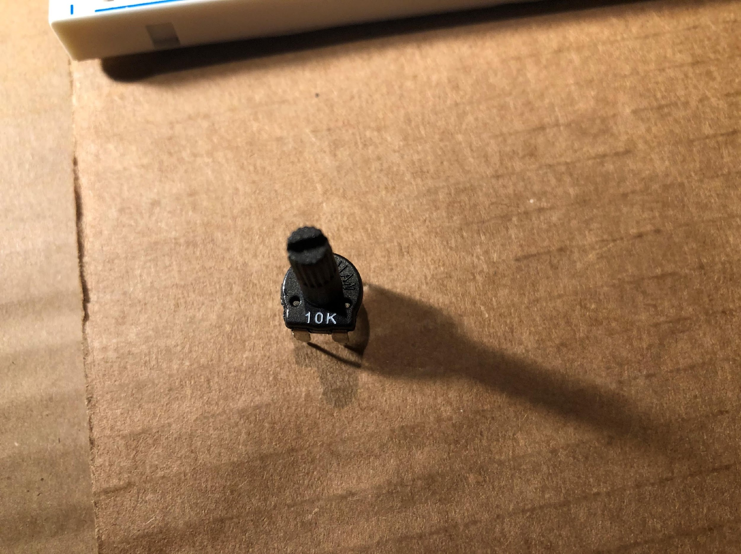
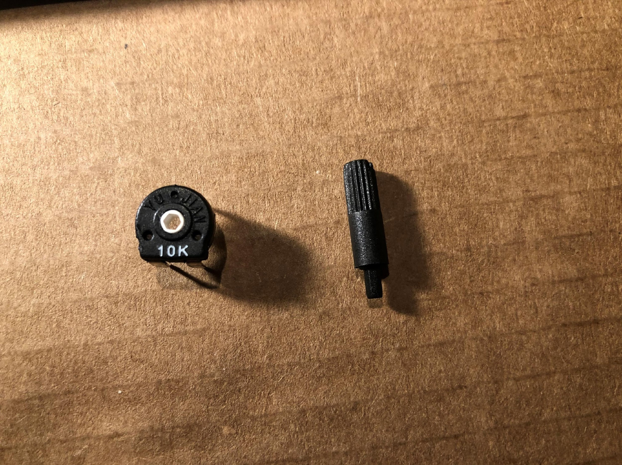
Materials
=
+

Slide 5
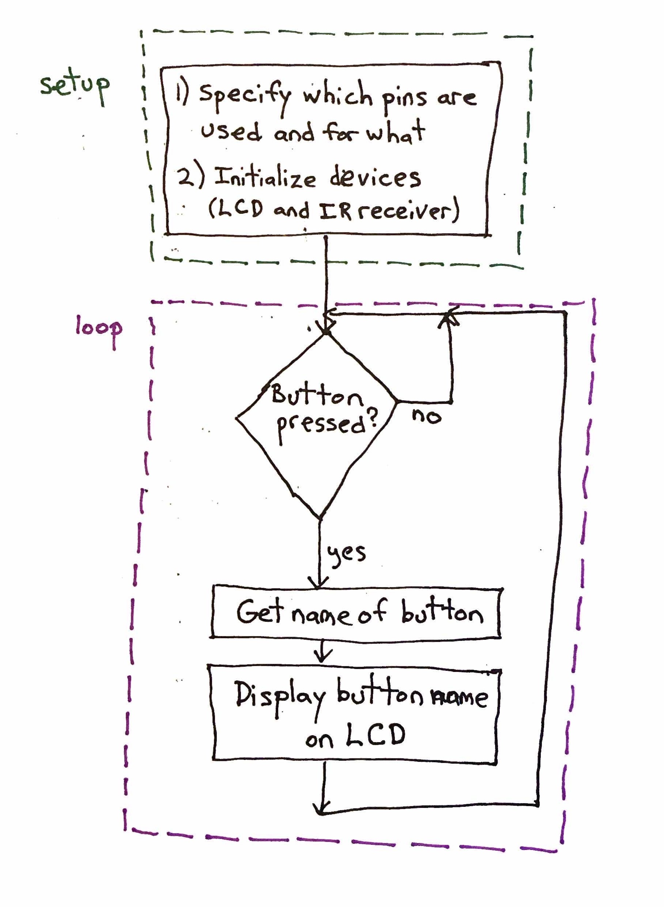
Conceptual code flowchart

Slide 6
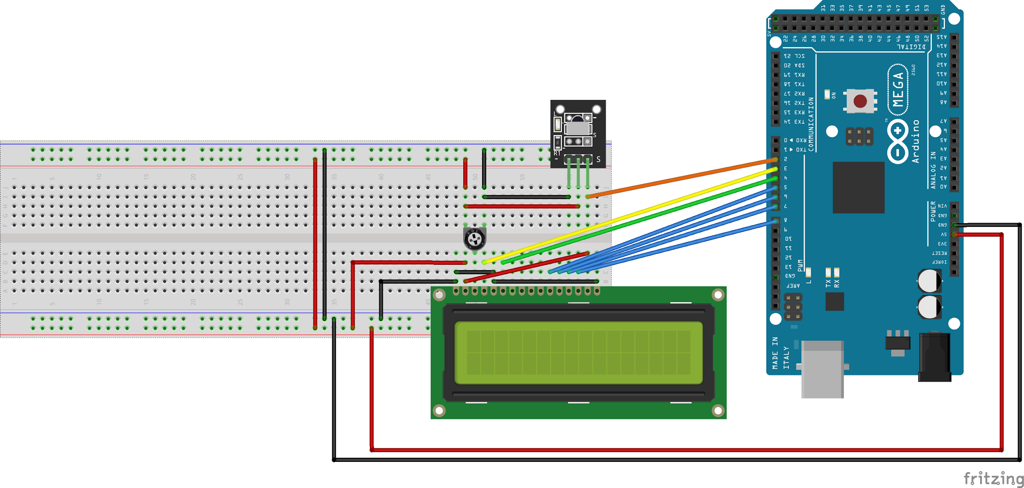
Breadboard placement and wiring diagram

Slide 7
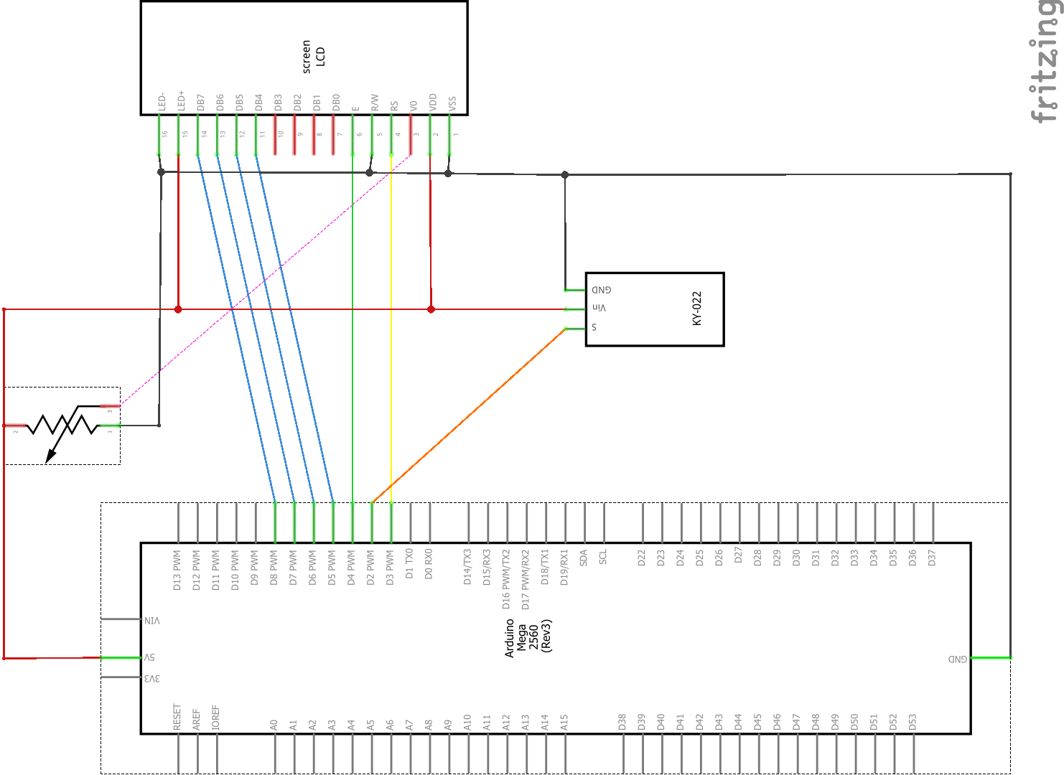
Circuit schematic

Slide 8
Arduino programming: Fundamental concepts
An Arduino program is called a sketch.
Sketches are written in a language called the “Arduino Programming Language,” which is essentially the same as C++ with a few extra functions provided.
The most common Arduino functions we’ll use in basic programs just:
Specify whether a pin is an input or an output, or
Read a value from or write a value to a pin, or
Print a debugging message that can be viewed on the host computer, if the Arduino is connected to the host
The full reference for the Arduino Programming Language can be found here: https://www.arduino.cc/reference/en/
Most Arduino components (sensors, motors, displays, etc.) have a library that makes them easy to use with an Arduino. A library is just code that you don’t have to write yourself. You can write your own libraries, too!

Slide 9
Arduino programming: Minimum requirements for a sketch
The only absolute requirement for an Arduino sketch is that it has one function called setup and one function called loop.
The setup function is called only once, when the sketch starts; that occurs whenever the Arduino first powers up or when it resets (typically by pushing the reset button, although it’s possible to use code to do a reset).
The loop function runs after the setup function, and it runs continuously in a (surprise!) loop, until the Arduino either powers down or is reset.
Either function could be empty if you didn’t need it, although that would be rather unusual.

Slide 10
Arduino programming: Structure for a typical sketch
Although the minimum requirement is just having setup() and loop(), most basic sketches have this structure:
Include a header file for each library you need to use
Define some constants to make it easier to refer to each pin, or to change which pins you use.
For components that use a library, you typically create one C++ object to represent that component.
In the setup() function, specify which pins are used as inputs and which as outputs, unless an object from a library already did that.
Do all of the interesting stuff in the loop() function.

Slide 11
Now, back to our original flowchart for this project…
#include <LiquidCrystal.h>
#include <IRremote.h>
#define PIN_LCD_RS 3
// … more pins here
#define PIN_IR_RECEIVER_Y 2
IRrecv irReceiver(PIN_IR_RECEIVER_Y);
LiquidCrystal lcd(PIN_LCD_RS, …);
void setup()
{
lcd.print("Ready");
irReceiver.enableIRIn();
}
void loop()
{
const char* buttonName =
irReceiver.getButtonName();
lcd.print(buttonName);
}
Include library headers
Define constants for pins
Create library objects
setup()
Initialize pins (no more actually needed here)
Initialize objects if needed
loop()
Get name of pressed button from IR receiver
Display button name on LCD

Slide 12
Okay, that code was slightly oversimplified
In theory, we could write just exactly the code from the previous slide, but:
The libraries that already exist don’t provide exactly those functions and require a little more setup
We’d like to add some debugging printouts to help make sure things are working the way we want and to figure out what’s wrong if they aren’t
We’d like to make our code a little easier to extend, e.g. if we add a light or motor to our circuit and want to use the buttons to control those too, rather than just printing the button name.
The IR receiver has one extra behavior we need to deal with: if the user holds down a button on the remote, the receiver object will report just “repeat” rather than the name of the button.

Slide 13
Now it’s time for you to go for it!
All of the code, wiring diagrams, and documentation can be downloaded from https://github.com/arduinofromzero/ir_and_lcd. Just click on the “Code” button and then “Download ZIP"

